Slide 1
Town of Cecilton
Drinking Water
Pearce Creek Implementation Committee
June 16, 2017

Slide 2
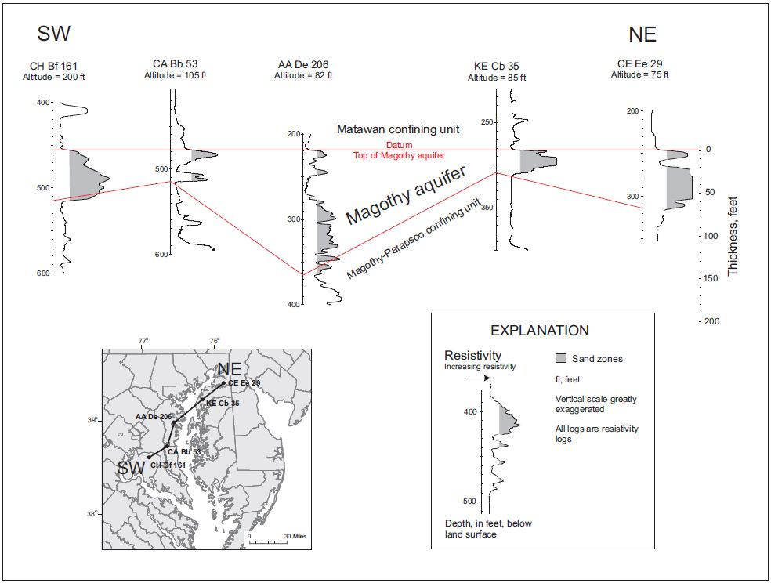
Overview
The Town water is sourced from a confined aquifer (Magothy Formation) that lies about 100 feet below land surface.
Once the water is pumped from the aquifer, it is then treated before it enters the Town’s water distribution system.
Notes:
Aquifer: An underground geological formation able to store and yield water. Artesian (or confined) aquifer: exist where the groundwater is bound between layers of impermeable substances like clay or dense rock.
The Magothy aquifer is an important source of water for both public and domestic supply on Maryland’s western shore in Anne Arundel and Charles Counties, and in the central and northern portions of the Eastern Shore of Maryland in Cecil, Dorchester, Kent, Queen Anne’s, and Talbot Counties.
GEOLOGY
The Magothy aquifer consists chiefly of the sandy portions of the Magothy Formation. The aquifer may also include portions of the Patapsco Formation in locations where there is a sand-on-sand contact with the underlying Patapsco Formation. Examples of this occur in east-central Anne Arundel County, and parts of Kent County, Maryland. On the Eastern Shore, the aquifer may include sand of the Lower Cretaceous-age Raritan(?) Formation. The Magothy aquifer is composed of medium- to coarse-grained, light gray to white quartzose sands and gravels, interbedded with layers of white, gray and black clay. The sands are often described as being “sugary” in texture. Pyrite and lignite are common accessory constituents.
GEOMETRY AND EXTENT
The Magothy aquifer is present in the central portion of Maryland's western shore. On the Eastern Shore, the unit is present from northern Dorchester, Wicomico, and Worcester Counties to southern Cecil County. In southern Maryland and the lower Eastern Shore, the Magothy aquifer pinches out on the southern flank of the Salisbury embayment The altitude of the top of the aquifer ranges from approximately 70 ft above sea level near its outcrop in Anne Arundel County to approximately 2,350 ft below sea level near Ocean City. Thickness ranges from zero ft at its pinchout to 214 ft in Anne Arundel County.
HYDRAULIC PROPERTIES
Transmissivity of the Magothy aquifer ranges from 445 to 24,000 ft²/d. The highest values typically occur in Anne Arundel County.
Electrical resistivity is an intrinsic (i.e. natural or essential) property of all materials. The properties that affect the resistivity of soil or rock include: porosity, water content, composition (clay mineral and metal content), salinity of the pore water, and grain size distribution. Therefore, the electrical resistivity method is ideally suited to provide information for ground water surveys and bedrock topography.
In an electrical resistivity exploration, electric current is applied to the ground surface through two electrodes. Two or three additional electrodes are placed in the ground to measure variations in the potential of the electrical field (voltage) that is set up within the earth by the current electrodes.
Electrical resistivity is an intrinsic property that quantifies how strongly a given material opposes the flow of electric current. A low resistivity indicates a material that readily allows the flow of electric current.
An electrical resistivity survey is a geophysical technique that produces an image of the subsurface showing the distribution of electrical conductivity, down to depths of several hundred feet. Fundamentally, dry rock has many orders of magnitude greater resistivity (lower conductivity) than rock that contains water.

Slide 3
Drinking Water Regulations
SWDA
The Safe Drinking Water Act (SDWA) is the primary federal law that ensures the quality of national drinking water. The SWDA is overseen by the US Environmental Protection Agency (EPA).
MCLG
MCL
The MCLG is used to determine the Maximum Contamination Level (MCL). The MCL is the maximum level allowed of a contaminant in water that is delivered to any user of a public water system.
After review of the health effects data, the EPA sets a Maximum Contaminant Level Goal (MCLG). The MCLG is the maximum level of a contaminant in drinking water at which no known or anticipated adverse effect on the health of persons would occur, while allowing for an adequate margin of safety.
Notes:
Under the SWDA, the EPA sets standards for drinking water quality and oversees the states, localities, and water suppliers who implement those standards.
MCLs are set at very stringent levels. To understand the possible health effects described for many regulated constituents, a person would have to drink 2 liters of water every day at the MCL level for a lifetime to have a one-in-a-million chance of having the described health effect.
EPA website lists each contaminant and limit (MCL - Maximum Contaminant Levels (MCLs)for drinking water quality).

Slide 4
Drinking Water Regulations
EPA Primary Drinking Water Regulations provide legally enforceable standards and treatment techniques that apply to public water systems.
  Primary Drinking Water Standards (primarily MCLs) apply to:
      Microorganisms
      Disinfectants
      Disinfection Byproduct
      Inorganic Chemicals (includes nutrients and metals)
      Organic Chemicals (i.e. pesticides and fuel additives)
      Radionuclides
      EPA Secondary Drinking Water Regulations provide non-enforceable guidelines regulating contaminants that may cause cosmetic effects (such as skin or tooth discoloration) or aesthetic effects (such as taste, odor, or color).
Notes:
EPA recommends secondary standards to water systems but does not require systems to comply with the standard.
They are established as guidelines to assist public water systems in managing their drinking water for aesthetic considerations, such as taste, color, and odor. These contaminants are not considered to present a risk to human health at the SMCL.

Slide 5
Drinking Water Regulations
The Maryland Department of the Environment (MDE) follows the EPA National Drinking Water Regulations.
MDE’s mission “is to ensure safe and sustainable supplies of water for drinking and other purposes to meet current and future needs of communities and ecosystems.”
The mission “is accomplished through proper planning for water withdrawal, protection of water sources that are used for public water supplies, oversight and enforcement of routine water quality monitoring at public water systems, regular onsite inspections of water systems, and prompt response to water supply emergencies.”
The Town of Cecilton’s drinking water meets
Federal and State requirements.

Slide 6
Consumer Confidence Reports
  The Town of Cecilton is required by law to issue a Water Quality Report, known as a Consumer Confidence Report (CCR), to the public every year. The report lists constituents that were detected (at any level) in the samples throughout the year, the reason the constituent is present, and any violations.
    List of constituents tested and testing frequency:
    Coliform - Minimum 5 samples per month
    Turbidity – Once per day
    Inorganic Chemicals (includes metals and nutrients) – Annually
    Volatile Organic Chemicals (VOCs) – Annually
    Synthetic Organic Chemicals (SOCs) – 2 quarterly samples per year
    Gross Alpha Particle Activity, Radium-226, Radium-228, Uranium – Once every 9 years
Please note that a detection does not mean an exceedance.
Notes:
nitrates (inorganic) may be quarterly if the reading is greater than ½ MCL)
Gross Alpha Particle Activity, Radium-226, Radium-228, Uranium (this is if the reading is below ½ the MCL, if it is above ½ the reading will be conducted once every 3 years)
Fines for each offence (not to exceed $100 each)and Any term or condition of an order issued is subject to the penalties provided by the subtitle pursuant to which the order is issued.
VOC = vapors or gases
SOC= i.e. pesticides and fuel additives
The Secretary may institute a civil action in any court of appropriate jurisdiction for injunctive relief to prevent violation of any order or regulation issued pursuant to this chapter, in addition to any other remedies provided under this chapter.
They also notify customers:
if the water does not meet drinking water standards;
if the water system fails to test its water;
if the system has been granted a variance (use of less costly technology); or
if the system has been granted an exemption (more time to comply with a new regulation).

Slide 7
Consumer Confidence Reports
Recent Town of Cecilton CCR findings (2014 - 2016):
  While there were some detections, there were NO exceedances.
  Most of the detections were caused by:
    Byproducts of the disinfection process
    Byproducts of chlorination
    Natural occurrences from surrounding geological formations
If you have any questions, please contact:
    The Town of Cecilton, MD
    P.O. Box 317
    Cecilton, Maryland 21913
    Phone: (410)-275-2692
Notes:
Reports are available on town website
Fines for each offence (not to exceed $100 each)and Any term or condition of an order issued is subject to the penalties provided by the subtitle pursuant to which the order is issued.
The Secretary may institute a civil action in any court of appropriate jurisdiction for injunctive relief to prevent violation of any order or regulation issued pursuant to this chapter, in addition to any other remedies provided under this chapter.
They also notify customers:
if the water does not meet drinking water standards;
if the water system fails to test its water;
if the system has been granted a variance (use of less costly technology); or
if the system has been granted an exemption (more time to comply with a new regulation).

Slide 8

Resources
For more information:
  Federal:
    https://www.epa.gov/sdwa
    https://www.epa.gov/dwregdev/drinking-water-regulations-and-contaminants
    https://www.epa.gov/environmental-topics/water-topics#what-you-can-do
    https://www.epa.gov/dwregdev/how-epa-regulates-drinking-water-contaminants
  State:
    http://mde.maryland.gov/programs/water/water_supply/Pages/index.aspx
    http://www.dsd.state.md.us/comar/SubtitleSearch.aspx?search=26.04.01.%2a

